Slide 1

Automating The Boring Stuff
WeShape Tech Talks
16th Feb 2023

Slide 2
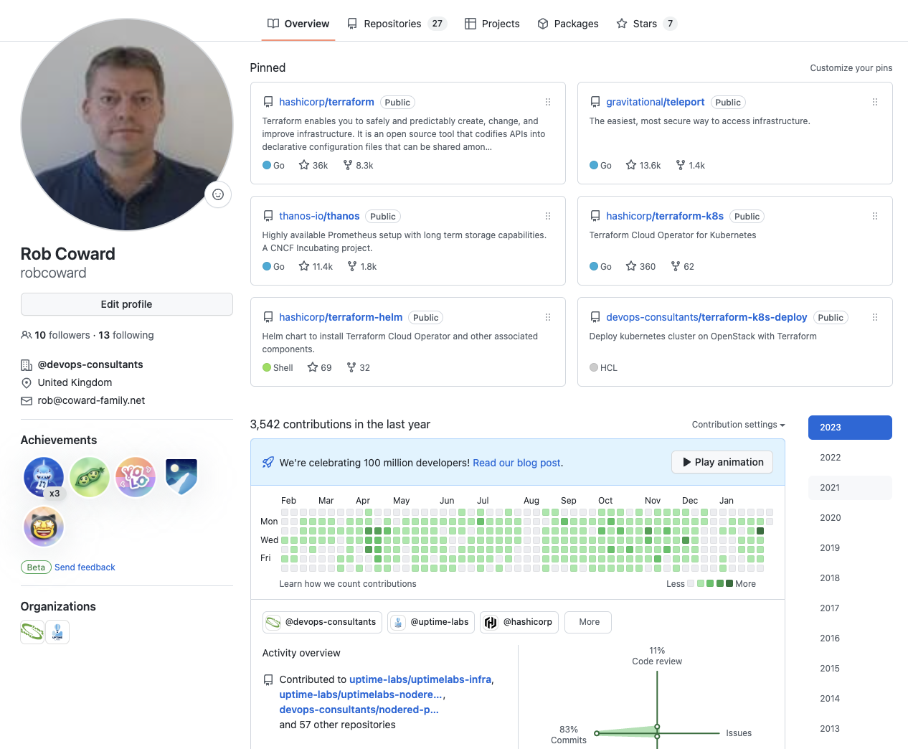



Who Am I ?
Rob Coward
Over 25 years in IT
Development Background
Linux / Unix Administration
Infrastructure Automation
Build Automation
Cloud Migration
Cloud-Native Deployments
Open-Source Contributor
github.com/devops-consultants
linkedin.com/in/robcoward/

Slide 3
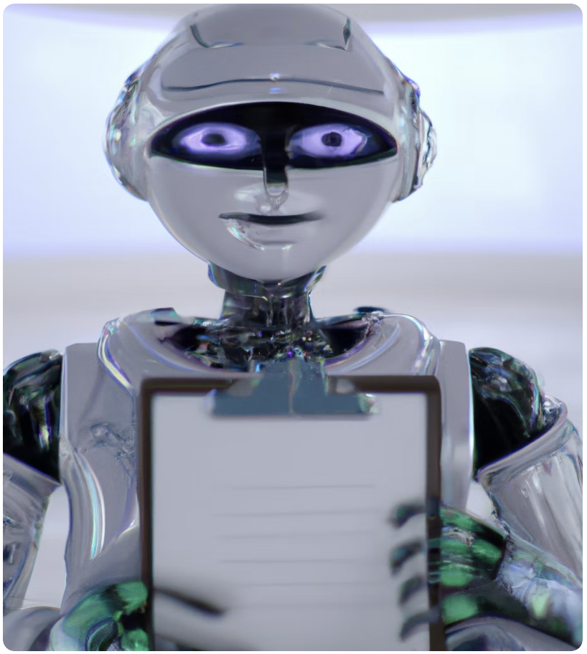
Automate the Boring Stuff
What is DevOps ?
Repeatability & Reliability
Automation in DevOps
The Boring Stuff ?
Demo

Slide 4
What is DevOps ?
“DevOps is a cultural and professional movement, focused on how we build and operate high velocity organizations, born from the experiences of its practitioners.” – Adam Jacob, cofounder and CTO of Chef.
Culture – development and operations teams working more effectively.
Automation – deliver consistent and more timely code releases.
Measurement – feedback for ongoing business improvements.
Sharing – building on learnings within the company.

Slide 5
Repeatability & Reliability
Repeatability refers to the ability of a process or task to be executed consistently, producing the same results every time it is run.
Reliability, on the other hand, refers to the ability of a system or process to be trusted to perform its intended function without fail.

Slide 6
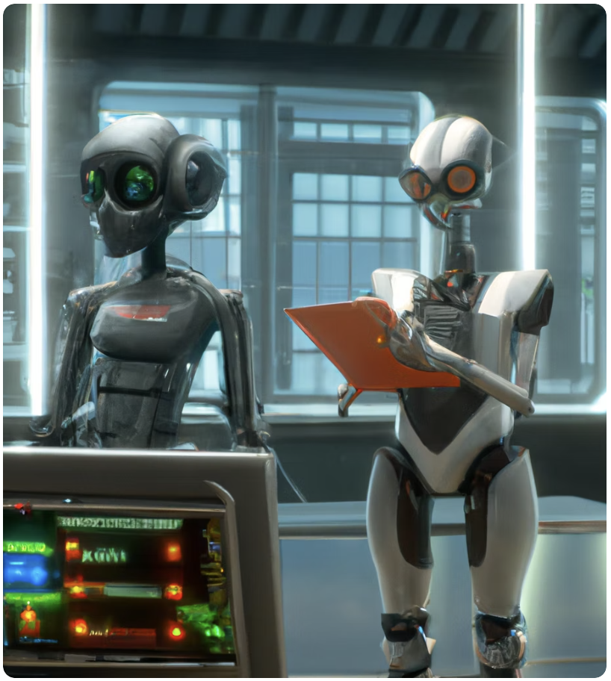
Automation in DevOps
Application Builds
(Virtual) Hardware Provisioning
Software Deployments
Testing
Configuration Management
Monitoring / Incident Response

Slide 7
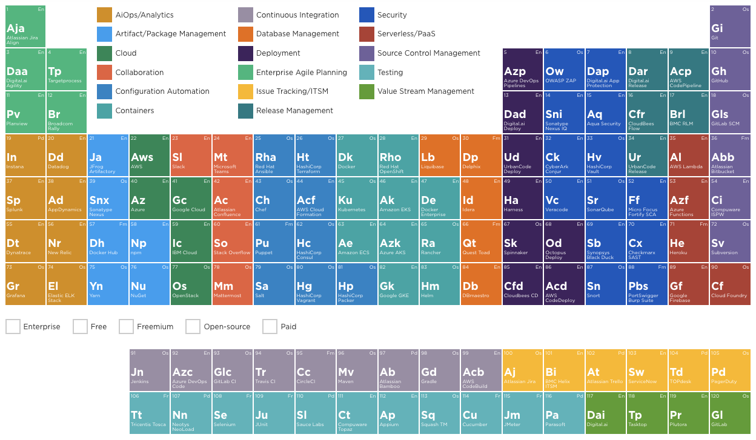


Slide 8
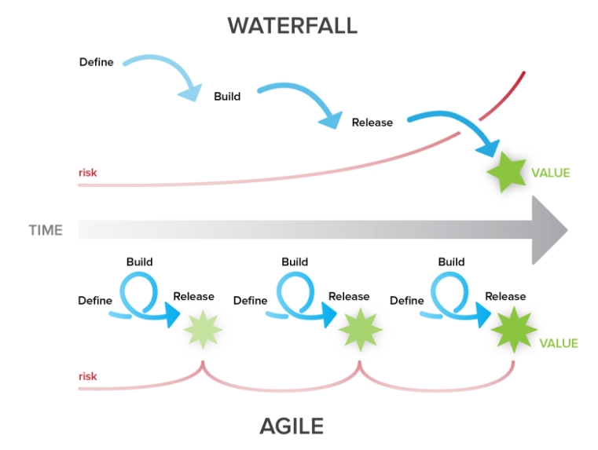
Shifting Left
Testing
Unit Testing
Integration Testing
UAT Testing
Performance Testing
Security
Customer Value / Business Outcomes

Slide 9
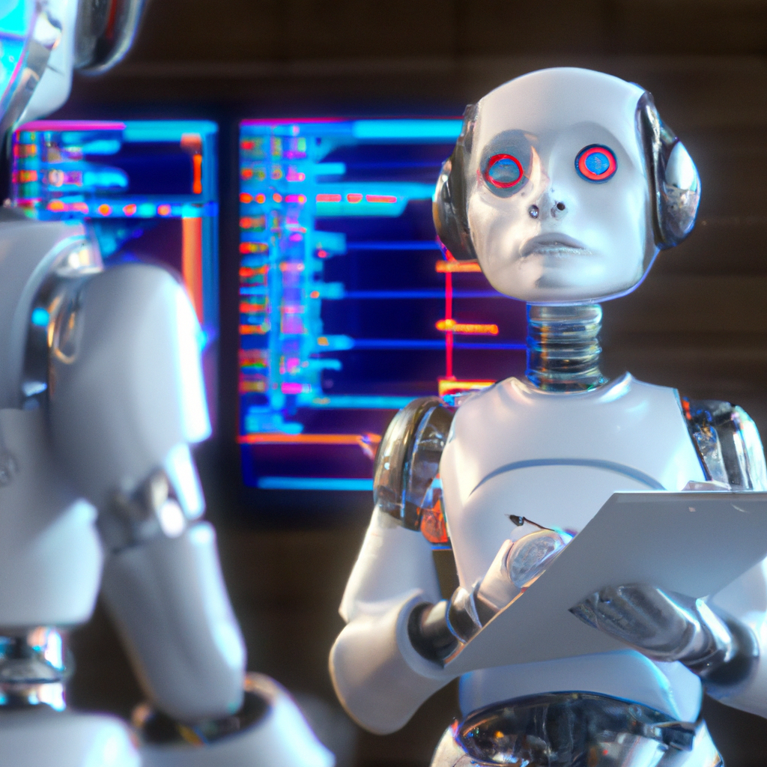

The Boring Stuff ?

Slide 10
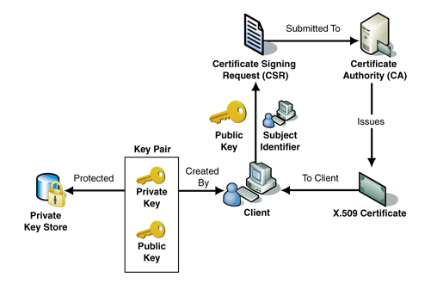
The Boring Stuff ?

Slide 11
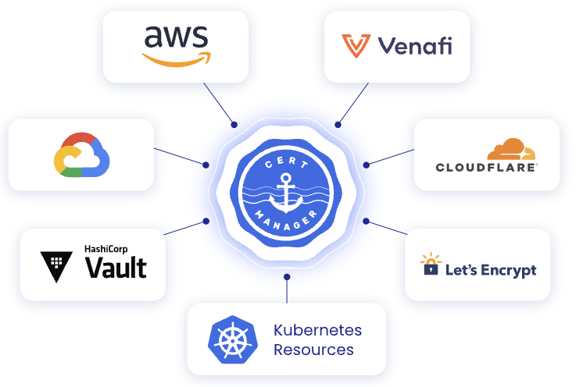
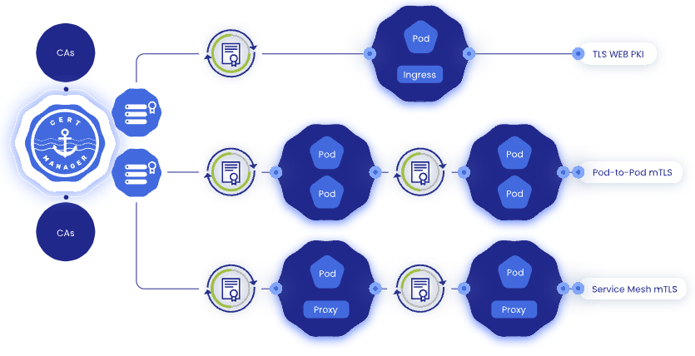
There is a Better way

Slide 12
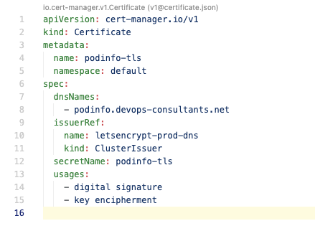
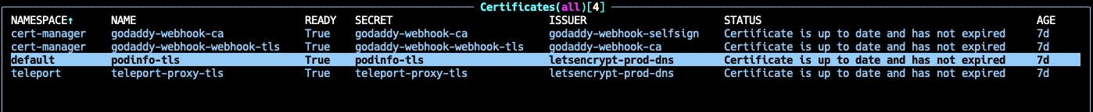
Certificate Resource

Slide 13
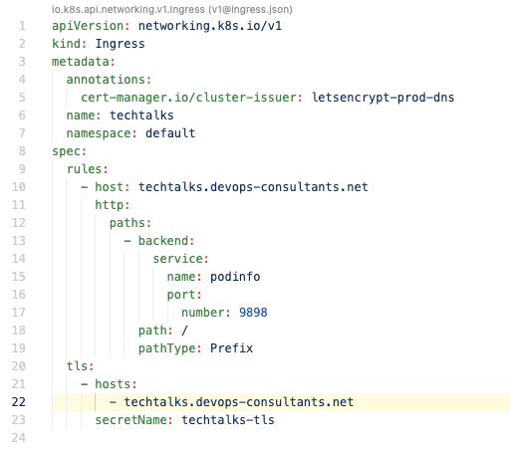
Ingress Resource

Slide 14
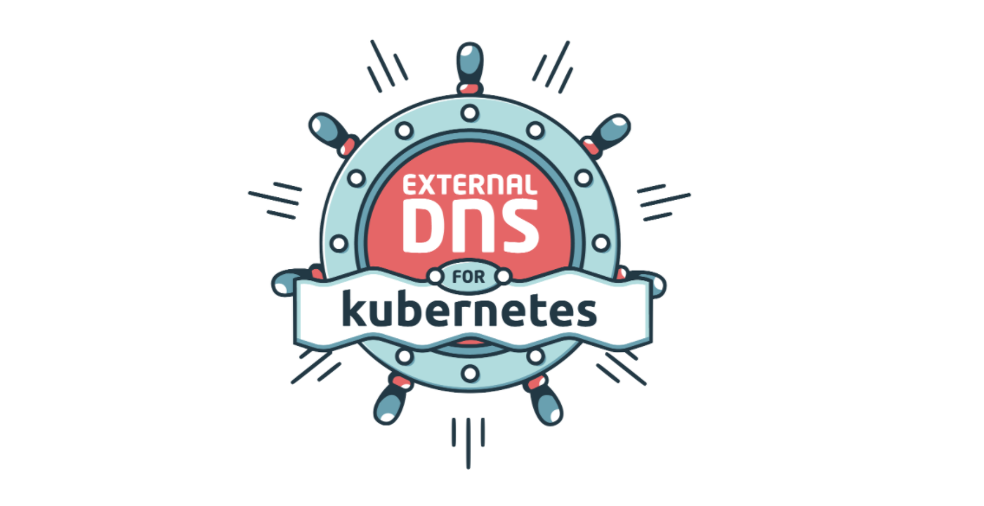

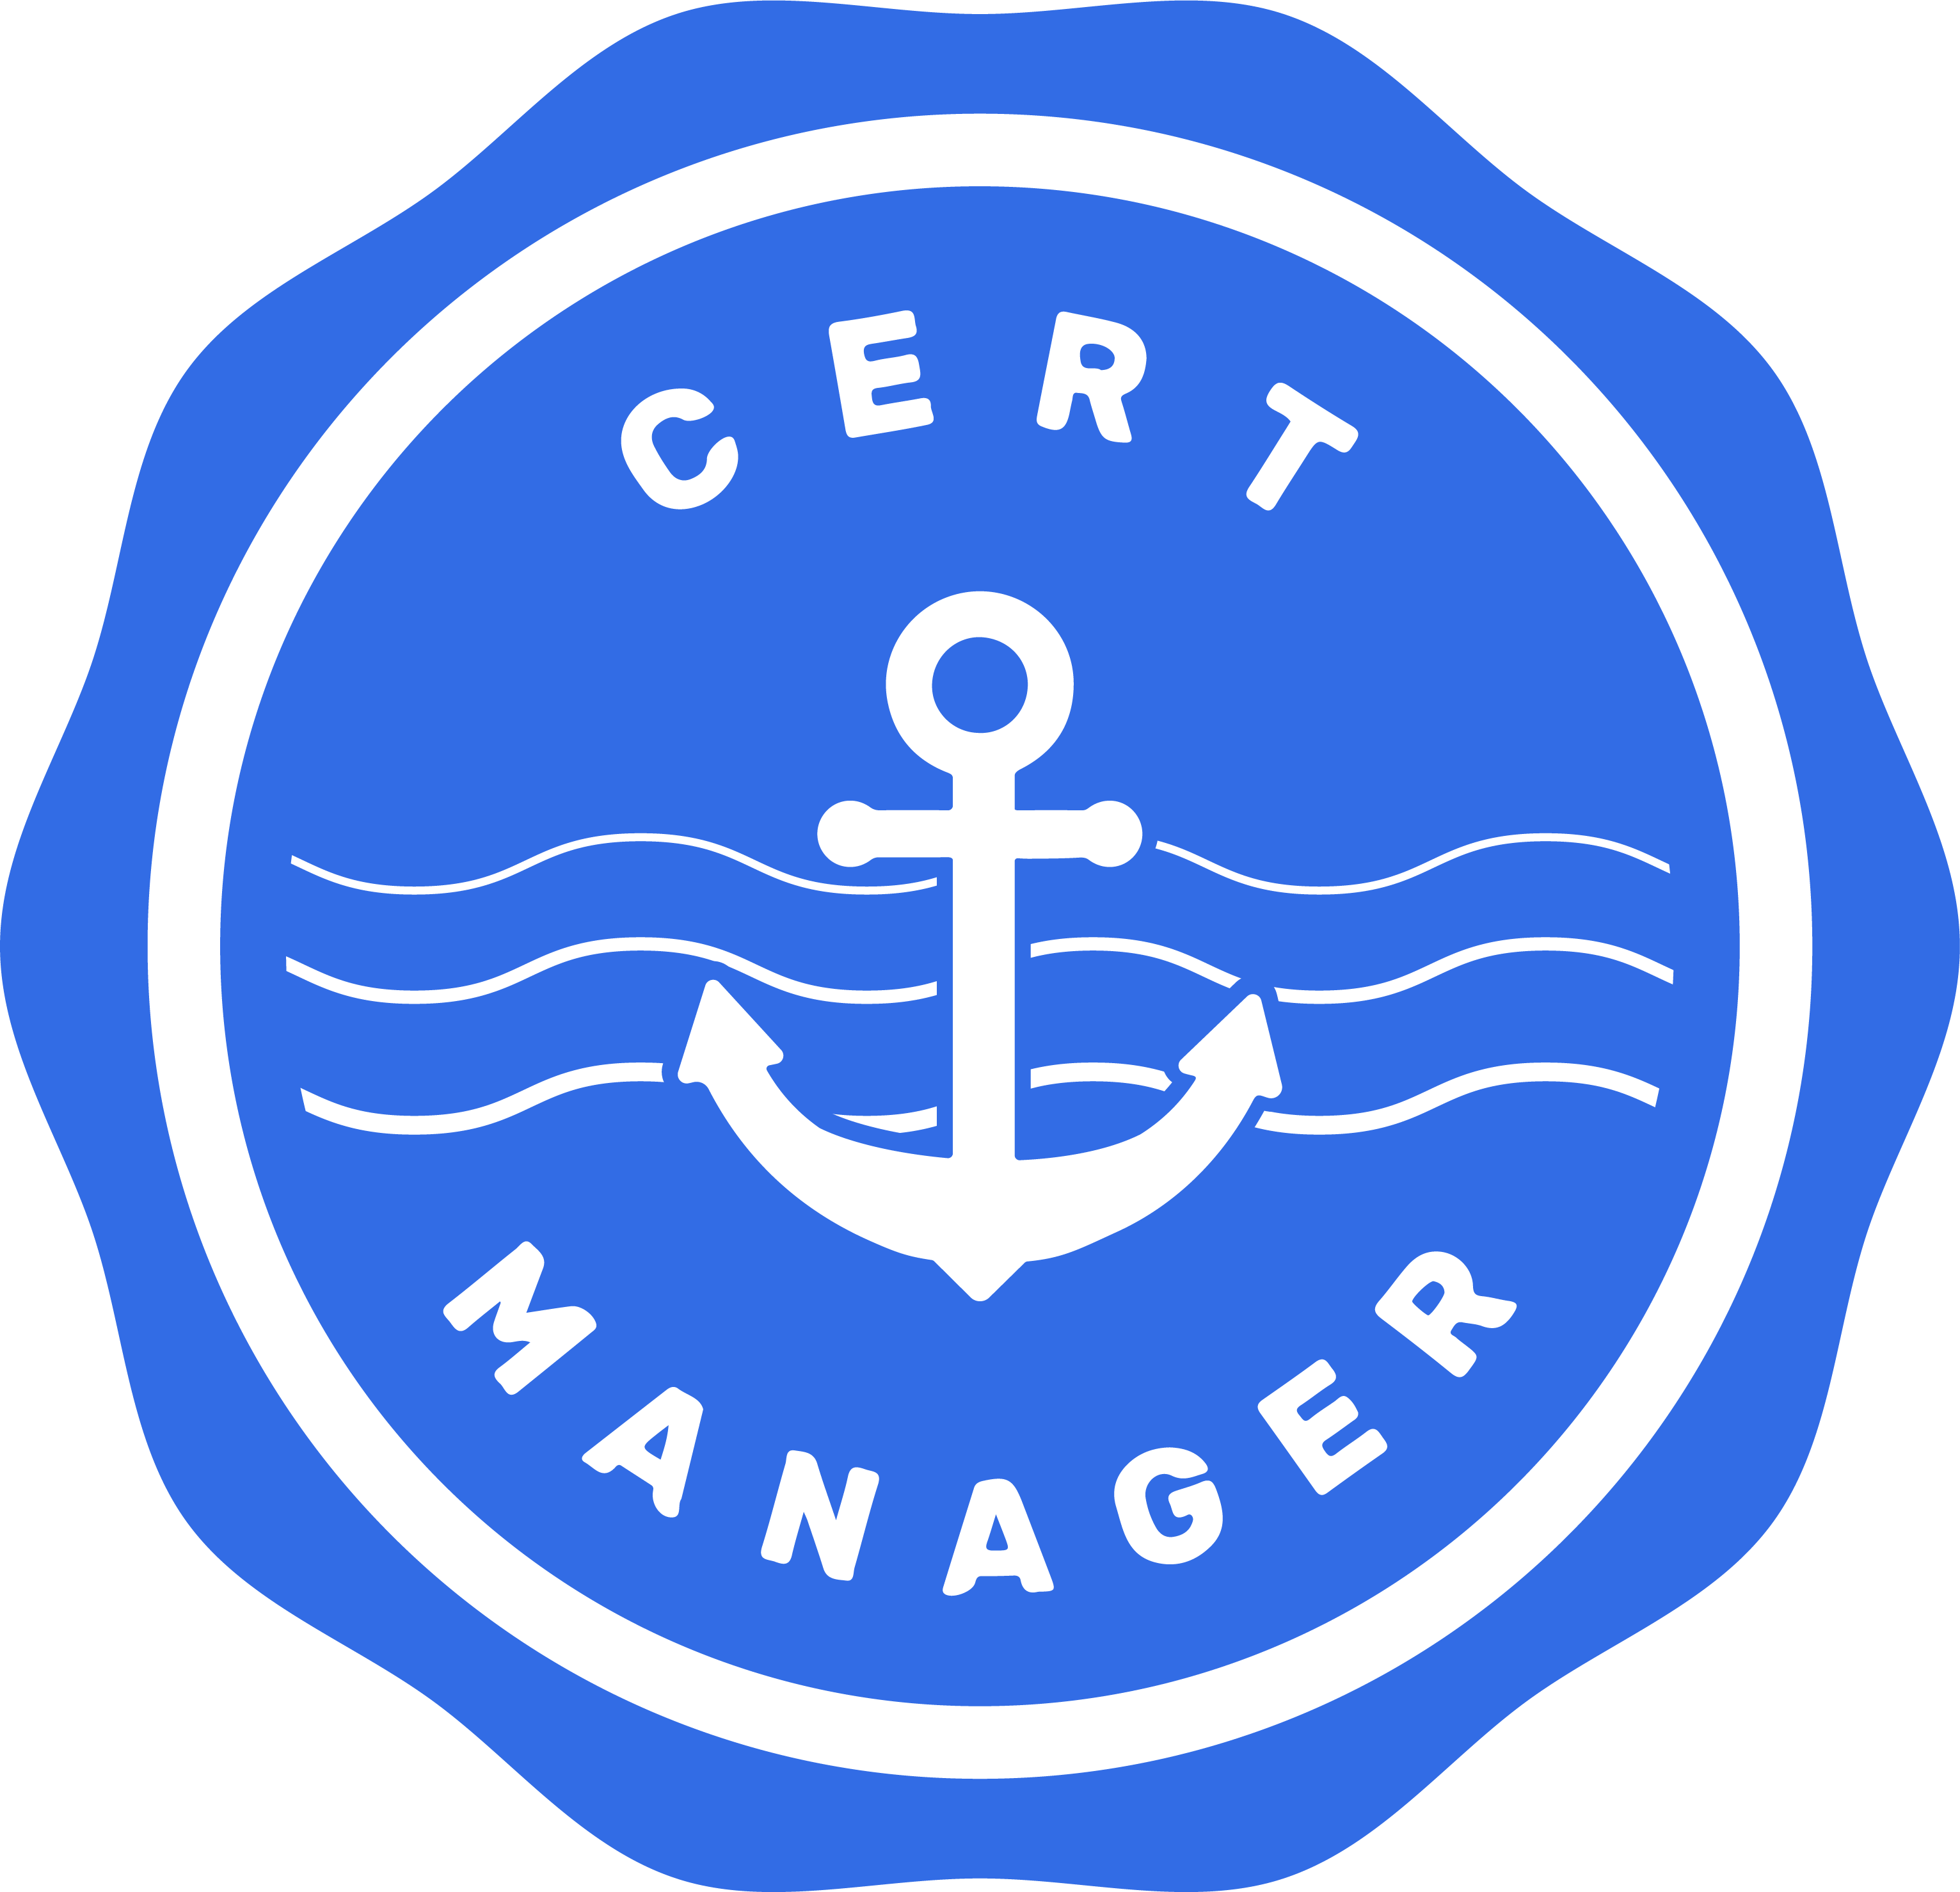

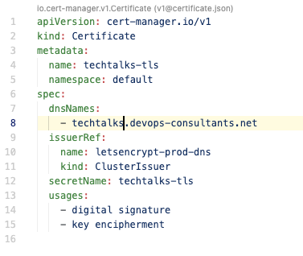




Demo

Slide 15

Demo

Slide 16
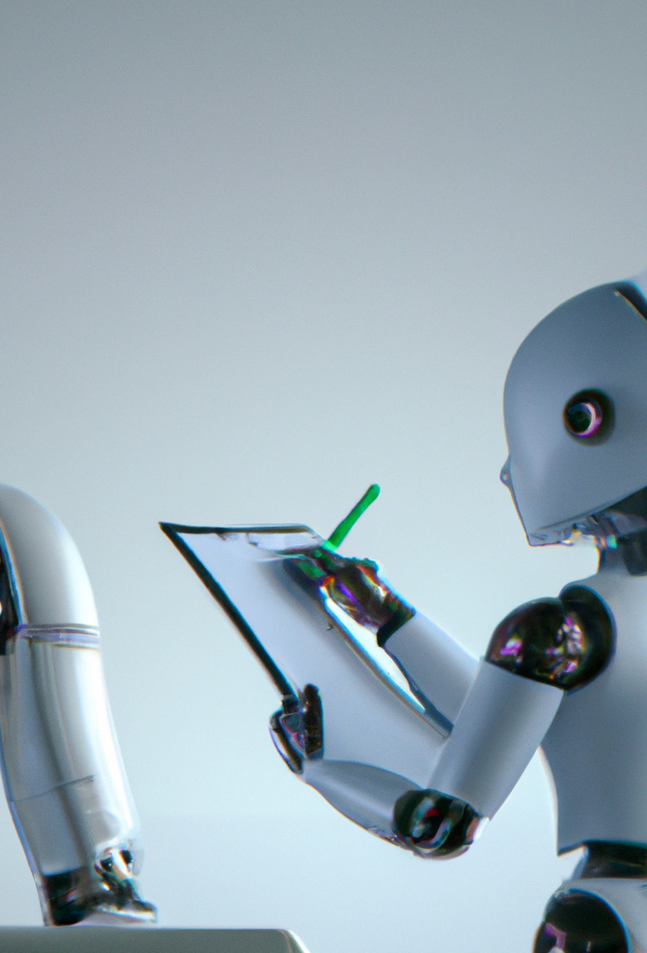
Links
github.com/devops-consultants/tech-talks
cert-manager.io/docs
github.com/kubernetes-sigs/external-dns

